Slide 1
INTERFACING OF ESP8266 WITH BEAGLEBONE BLACK
GURPREET SINGH(C0761753)
GROUP #2

Slide 2
TABLE OF CONTENT
PROJECT OVERVIEW
REQUIREMENTS FOR INTERFACING
Hardware Requirements
Software Requirements
BRIEF INTRODUCTION OF BEAGLEBONE
Pin Layout
INTRODUCTION TO ESP8266
Features
Pin layout
INTERFACING OF BEAGLEBONE BLACK
Schematic layout
Connections of beaglebone black and ESP8266
Enabling UART ports
Libraries include in coding
Coding
TERMINAL OUTPUT
REFERENCES

Slide 3
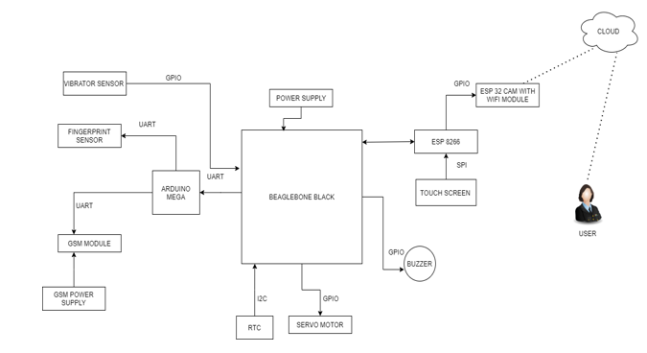
PROJECT OVERVIEW

Slide 4
UNTIL NOW…
After the successful interfacing of buzzer, Servo motor, Vibration sensor, Arduino mega, Fingerprint sensor, and GSM SIM900 module the next task is interfacing of ESP8266 with Beaglebone Black.
GPIO communications is used for interfacing of buzzer, Servo motor, Vibration sensor except the fingerprint sensor, GSM SIM900 Module and Arduino Mega in which UART was used.
For interfacing of ESP8266 module with Beaglebone Black UART communication protocol is used.

Slide 5
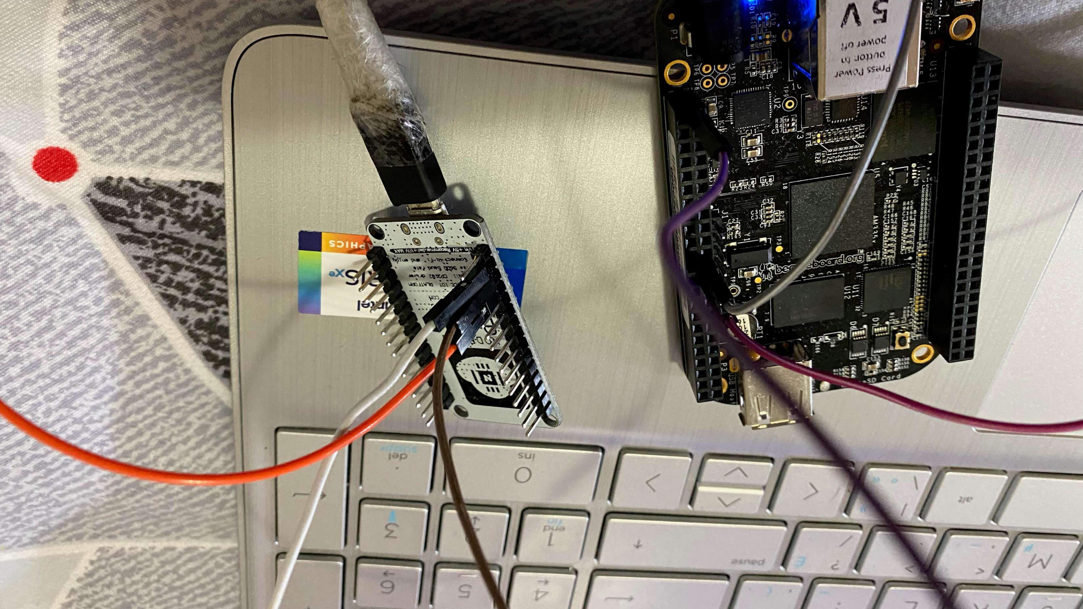
REQUIREMENTS
For interfacing of ESP8266 Module with beaglebone black there are various hardware and software requirements.

Slide 6
HARDWARE REQUIREMENT
ESP8266 Module
Beaglebone Black
Jumper Wires
USB Cable
Laptop

Slide 7
SOFTWARE REQUIREMENTS
Terminal
Arduino IDE
GCC Compiler
GNU Nano Text Editor

Slide 8
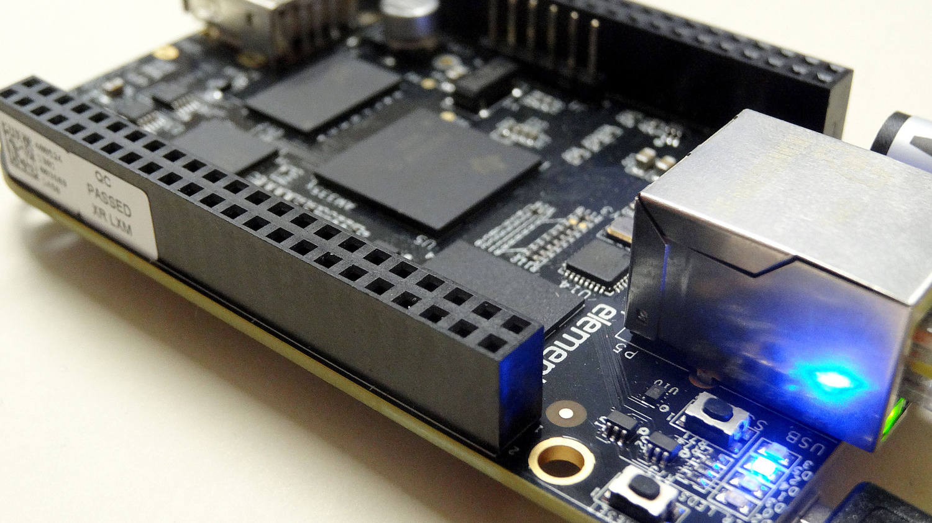
INTRODUCTION TO BEAGLEBONE
Beaglebone Black is our main microcontroller unit as all the components are connected directly or indirectly to it.
It is a low-cost, community-supported development platform.
This Photo by Unknown Author is licensed under CC BY-NC

Slide 9
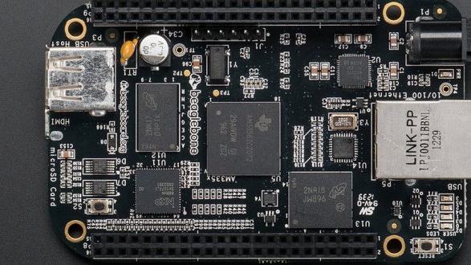
FEATURES
It has a range of IO including USB, SPI, I2C, UART, LCD, and GPIOs.
Connectivity
USB client for power & communications
USB host
Ethernet
HDMI
2x 46 pin headers
Software Compatibility
Debian
Android
Ubuntu
Cloud9 IDE on Node.js w/ BoneScript library.
This Photo by Unknown Author is licensed under CC BY-NC

Slide 10
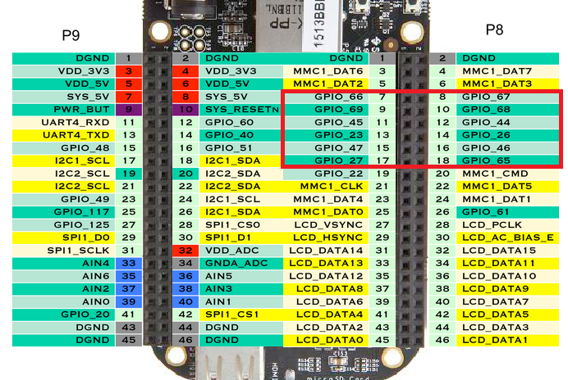
PIN LAYOUT OF BEAGLEBONE BLACK
These pins are used for interfacing

Slide 11
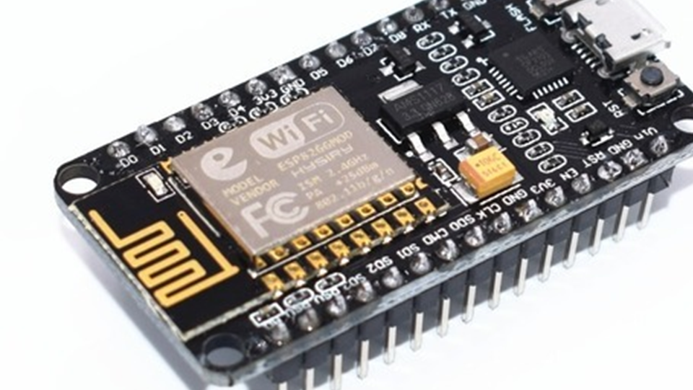
INTRODUCTION TO ESP8266
The ESP8266 is a System on a Chip (SoC), manufactured by the Chinese company Espressif.
It consists of a Tensilica L106 32-bit micro controller unit (MCU) and a Wi-Fi transceiver.
There are many different modules available, standalone modules like the ESP-## series by AI Thinker, or complete development boards like the NodeMCU DevKit or the WeMos D1.

Slide 12
FEATURES
The operating voltage for this board is 3.3V
There are 16 GPIO line available some of them are used internally for devices like flash memories
2 pins out of 11 GPIO are reserved for the are reserved for communication Rx and Tx pins
D0 to D8, total 9 pins are used as GPIO pins.
SD1, CMD, SD0, CLK are four pins for SPI communication.
Two buttons are present on the board for flashing the device and reset.

Slide 13
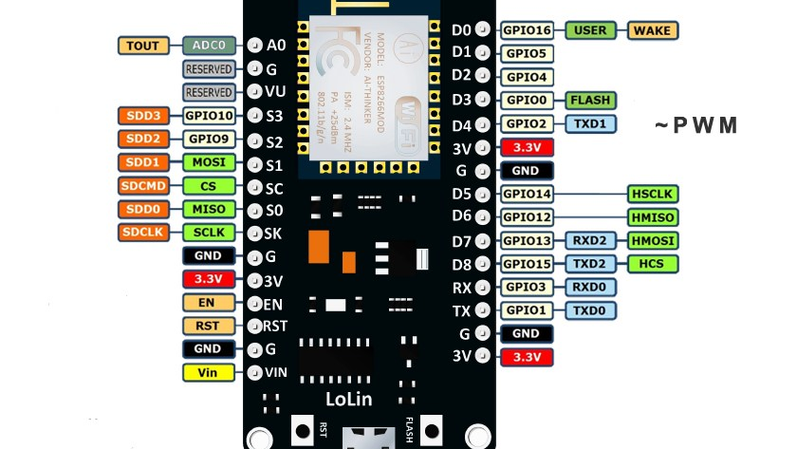
PIN LAYOUT
These pins are used for interfacing
This Photo by Unknown Author is licensed under CC BY-NC

Slide 14
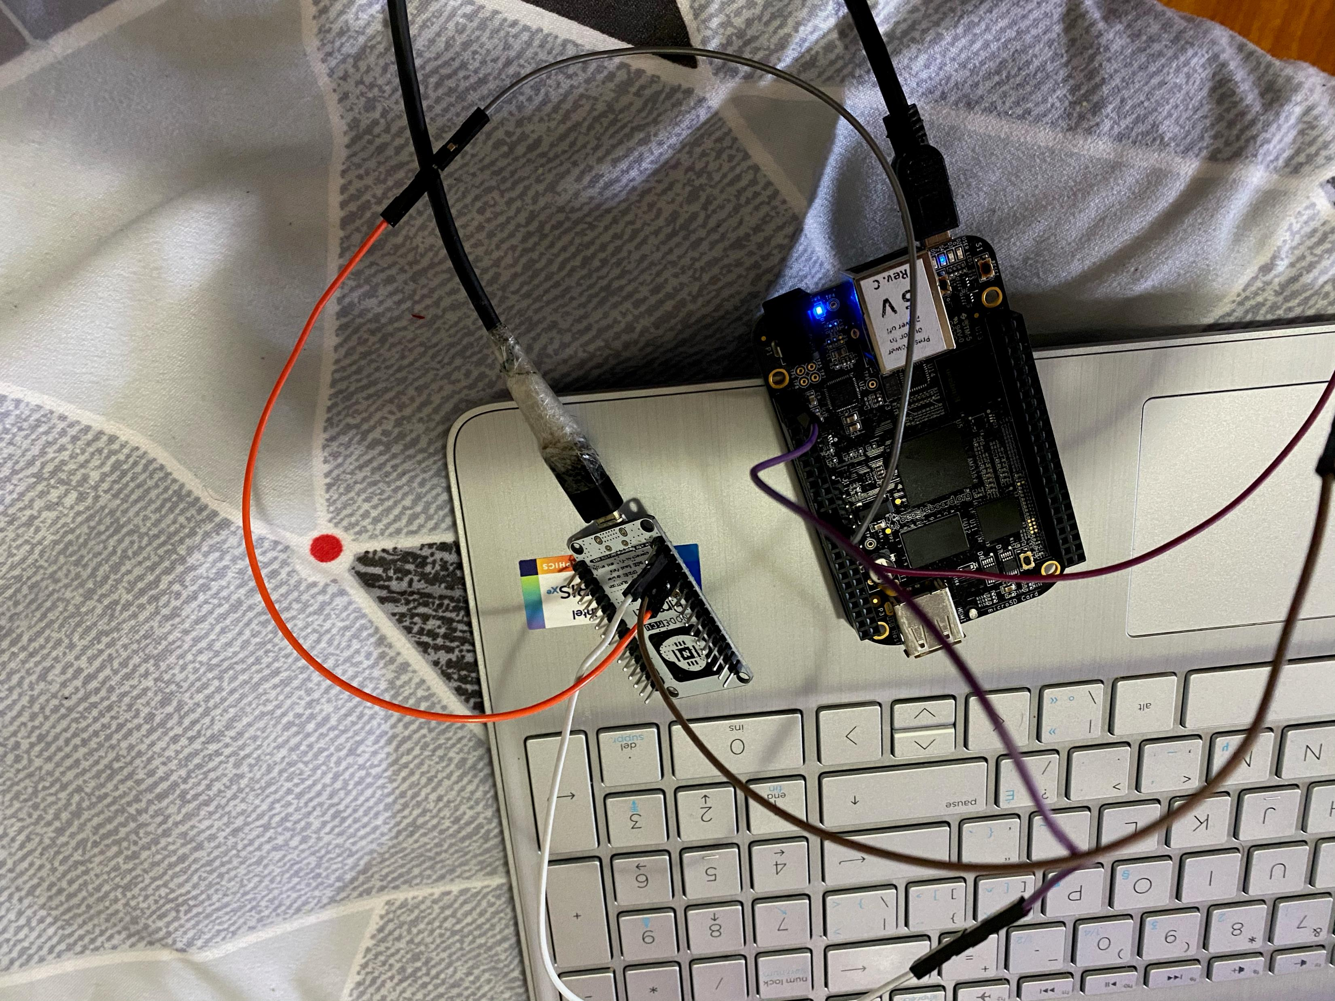
ROLE OF ESP8266
ESP8266 Module is also used as Wifi connectivity whereas in this project it is used for the interfacing of touchscreen.

Slide 15
INTERFACING OF ESP8266 WITH BEAGLEBONE BLACK
ESP8266 is communicating with beagle bone by UART communication.
We are using the ESP8266 in this project just for the interfacing of touch screen.
ESP8266 Module | Beaglebone Black
18 Tx | P9.26
19 Rx | P9.24
GND | GND
Vin | P9.7

Slide 16
COMMUNICATION PROTOCOL
Beaglebone and ESP8266 are communicating with each other by UART communication.
By definition, UART is a hardware communication protocol that uses asynchronous serial communication with configurable speed. Asynchronous means there is no clock signal to synchronize the output bits from the transmitting device going to the receiving end.

Slide 17
COMMUNICATION PROTOCOL
ESP8266 Module has 2 UART Ports available, and we are using serial port1 of Beaglebone Black.
The Serial port 1 has pin 24- TX and Pin 26- RX.
These pins are connected to the ESP8266 Module to make the UART communication possible.

Slide 18
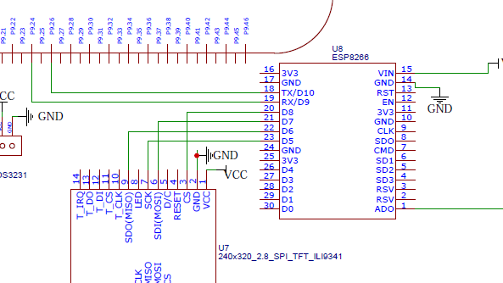
SCHEMATIC DIAGRAM

Slide 19
CONNECTIONS OF ESP8266 WITH BEAGLEBONE BLACK

Slide 20
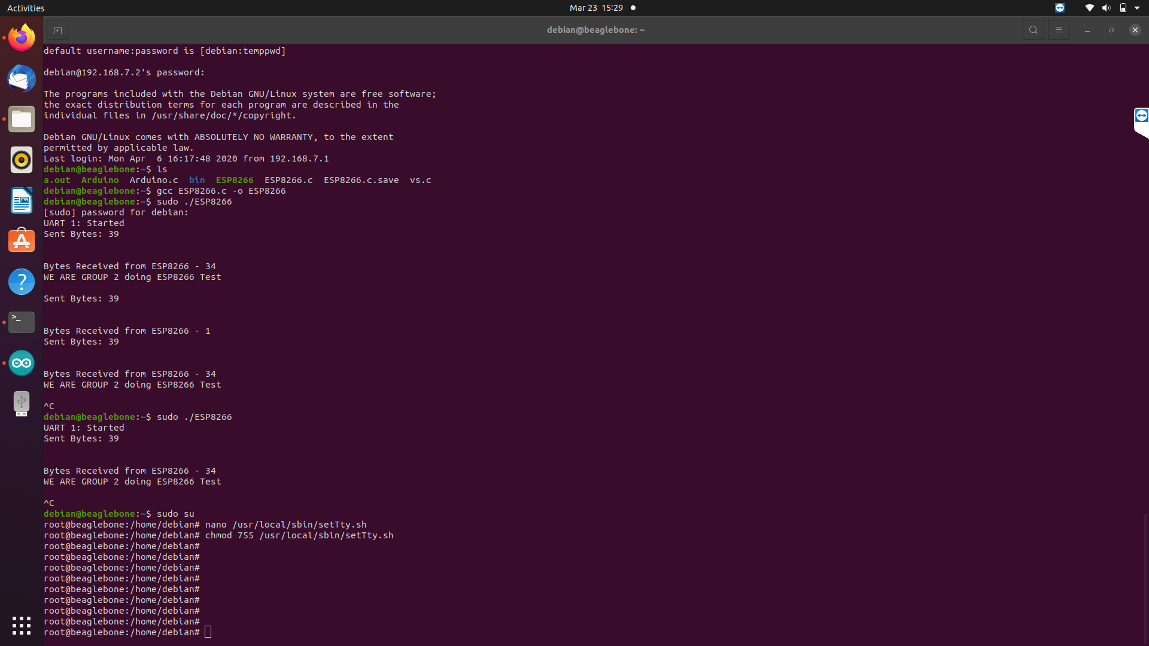
ENABLING THE UART PORT 1 OF BEAGLEBONE BLACK

Slide 21
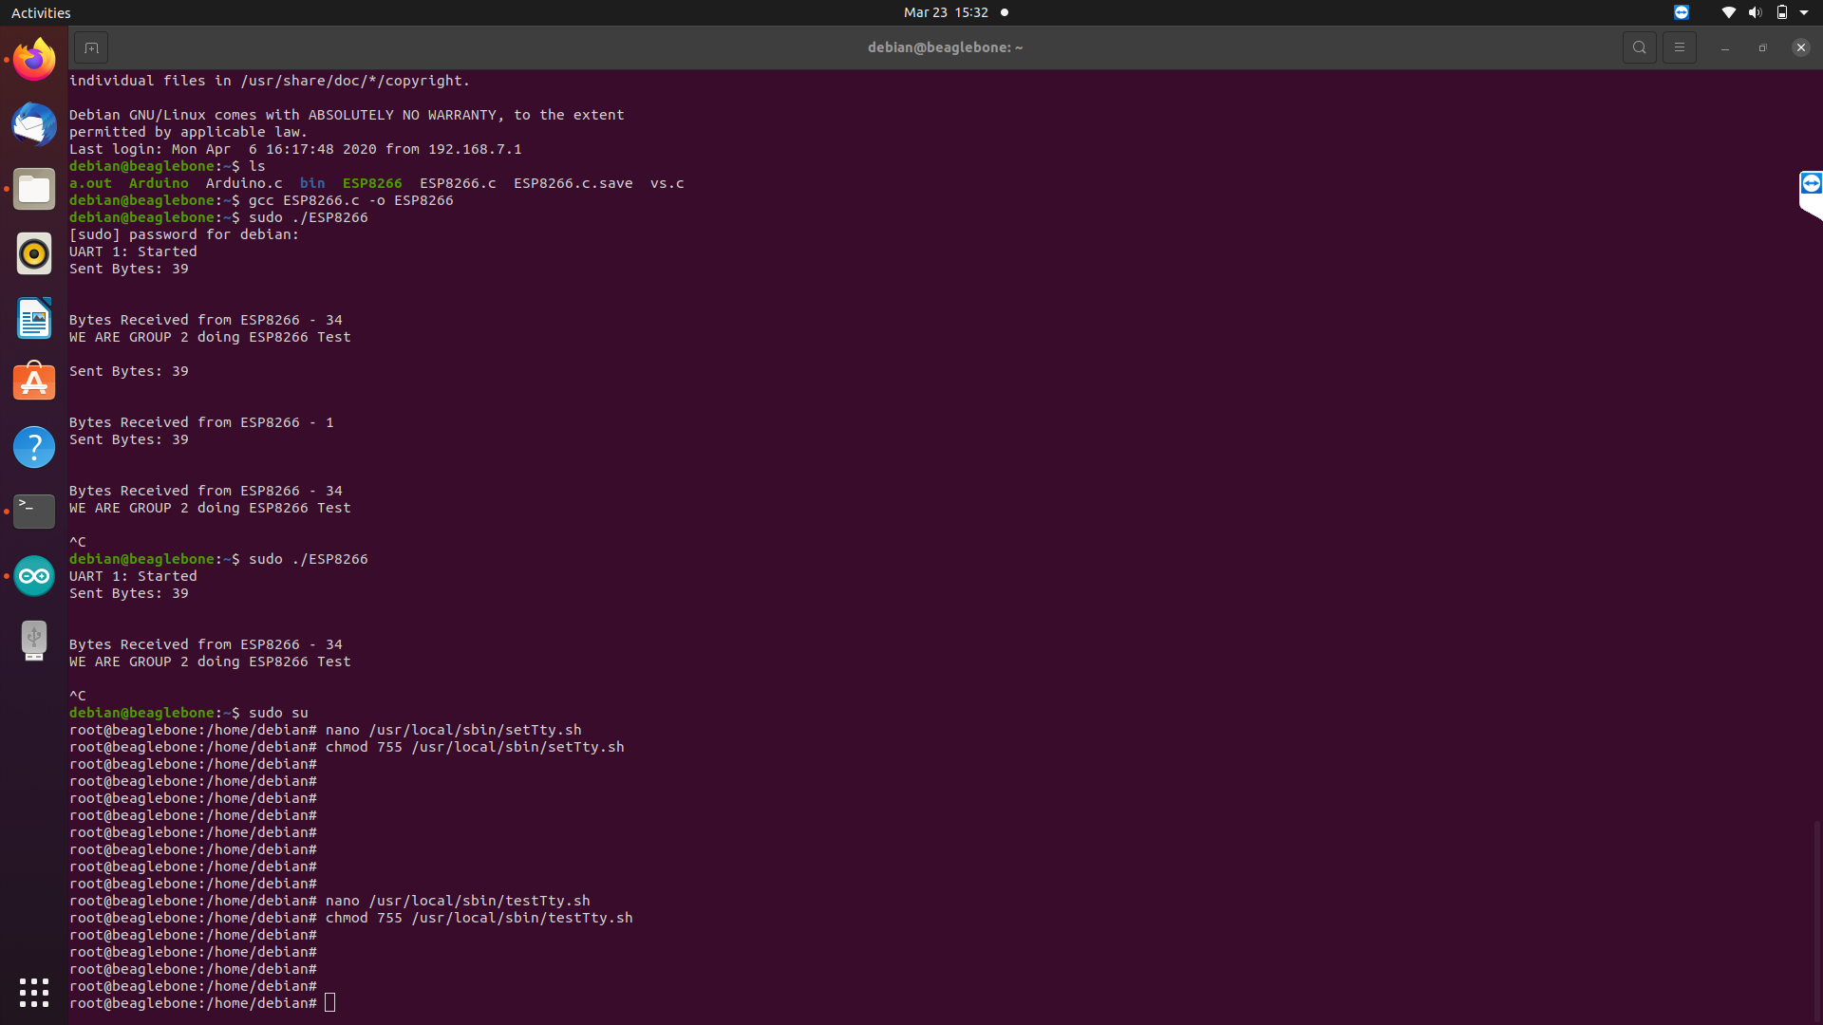
ENABLING THE UART PORT 1 OF BEAGLEBONE BLACK
To accomplish this task the few steps are followed:
Make a file under the name setTty.sh.
Command used at the terminal is :
nano/usr/local/sbin/setTty.sh
In this file bash script is written to configure the ports on the beaglebone side.

Slide 22
ENABLING THE UART PORT 1 OF BEAGLEBONE BLACK
Create a new file with the name testTty.sh.
Open the text editor with the sudo nano command.
nano /usr/local/sbin/testTty.sh.
Similarly make this file also executable like the last one.
chmod 755 /usr/local/sbin/testTty.sh.

Slide 23
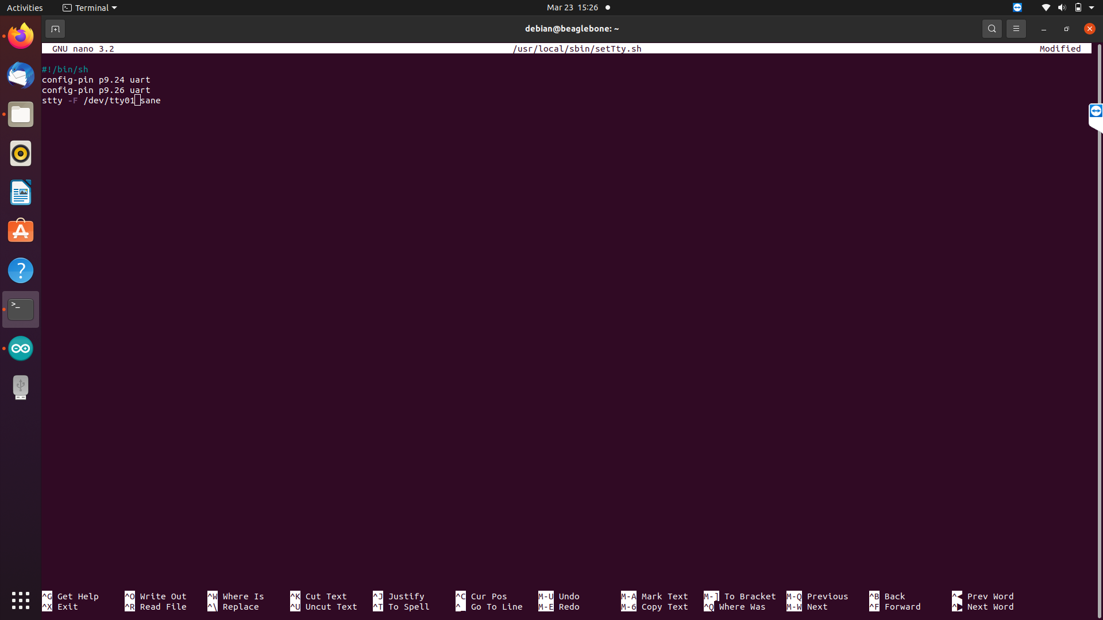
ENABLING THE UART PORT 1 OF BEAGLEBONE BLACK

Slide 24
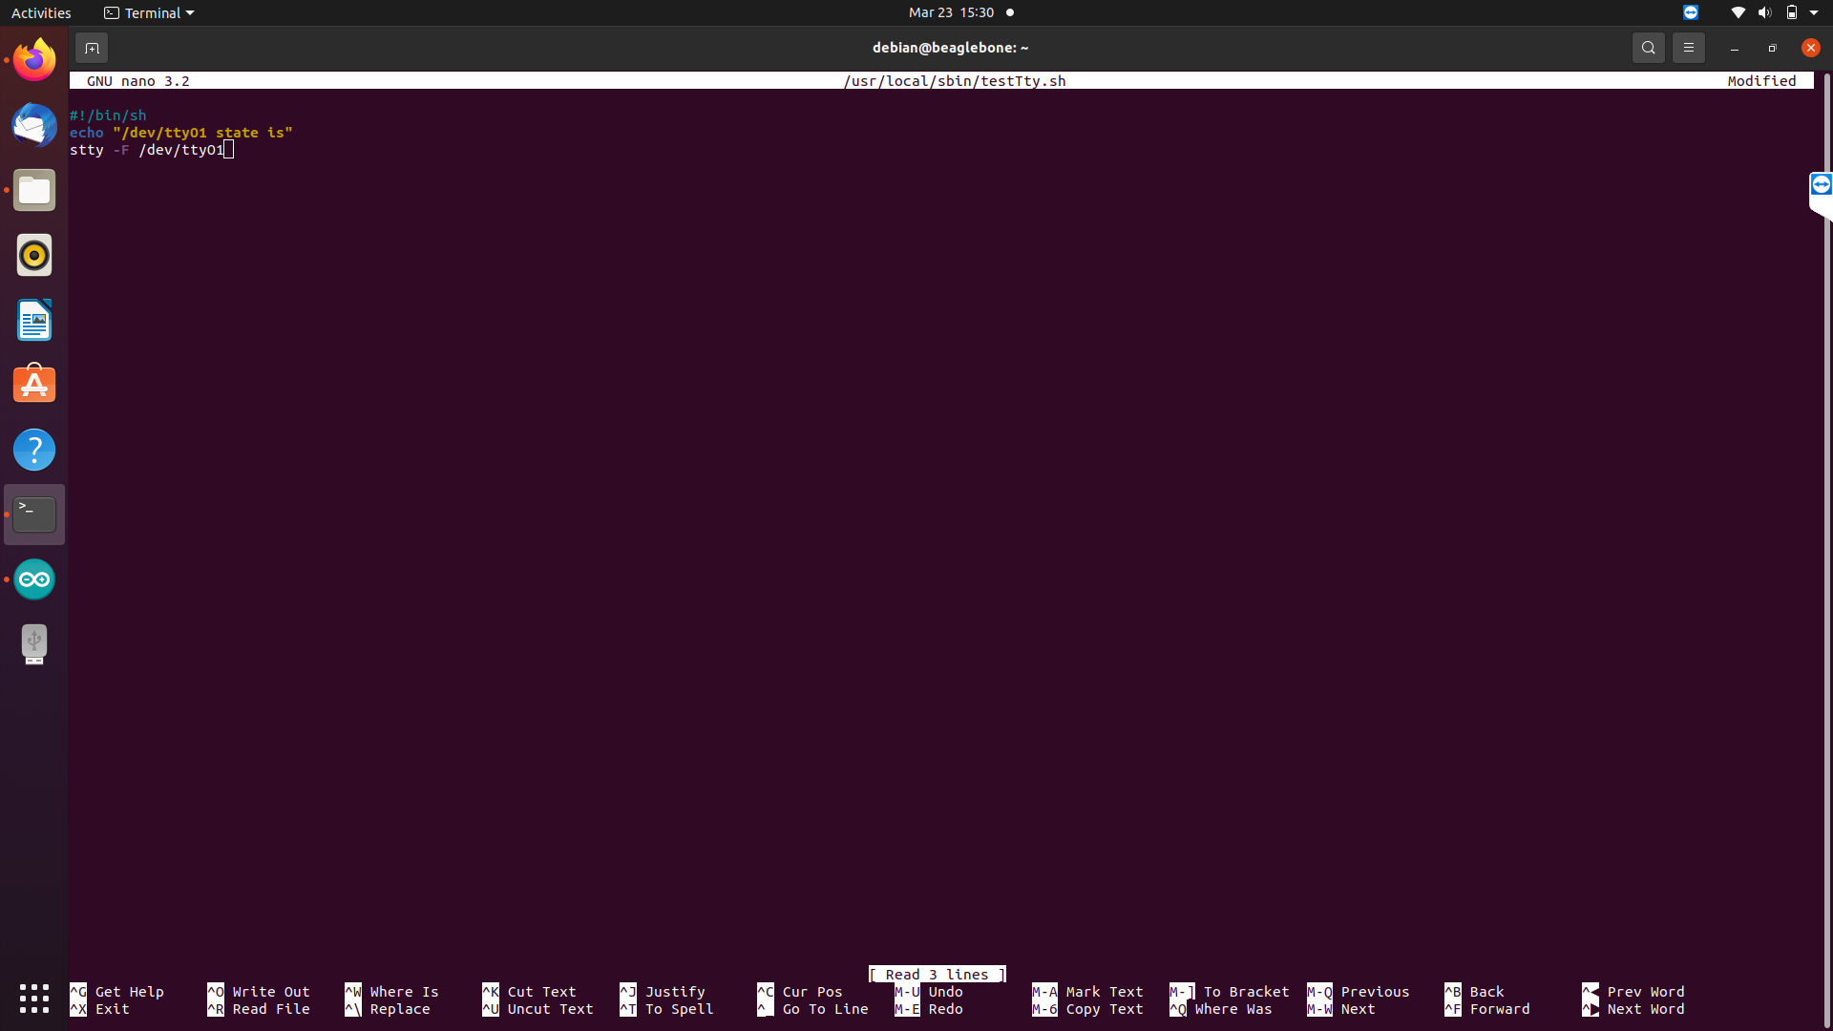
ENABLING THE UART PORT 1 OF BEAGLEBONE BLACK

Slide 25
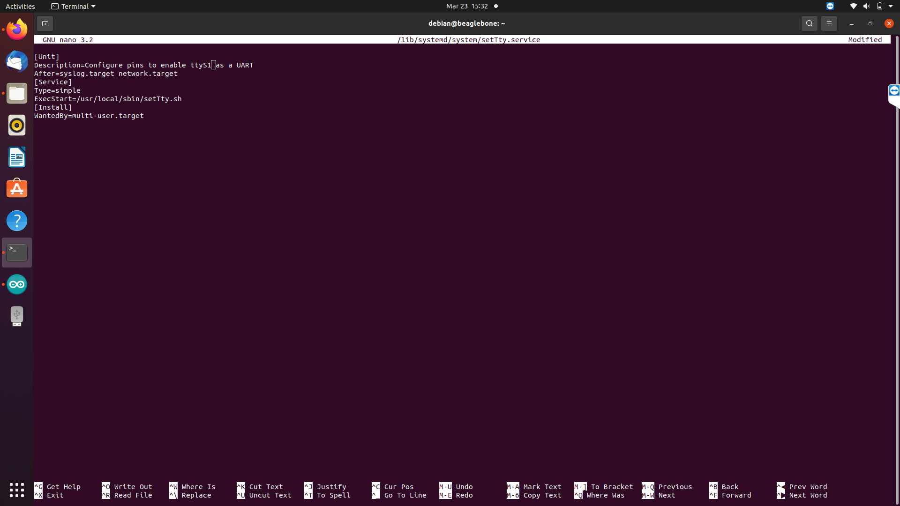
ENABLING THE UART PORT 1 OF BEAGLEBONE BLACK
Create the service configuration file that makes the system run it on startup
Command used : nano /lib/systemd/system/setTty.service.

Slide 26
LIBRARIES INCLUDED
stdio.h
Standard C input Output Library.
unistd.h
defines miscellaneous symbolic constants and types and declares miscellaneous functions.
string.h
C Library for various String Operations.
termios.h
Contains the definitions used by the terminal I/O interfaces.

Slide 27
LIBRARIES INCLUDED
fcntl.h
File control, Open, close.
time.h
The Time library provides the data structures and functions required to retrieve the system time, perform time calculations, and output formatted strings that allow the time to be displayed in a variety of common formats.

Slide 28
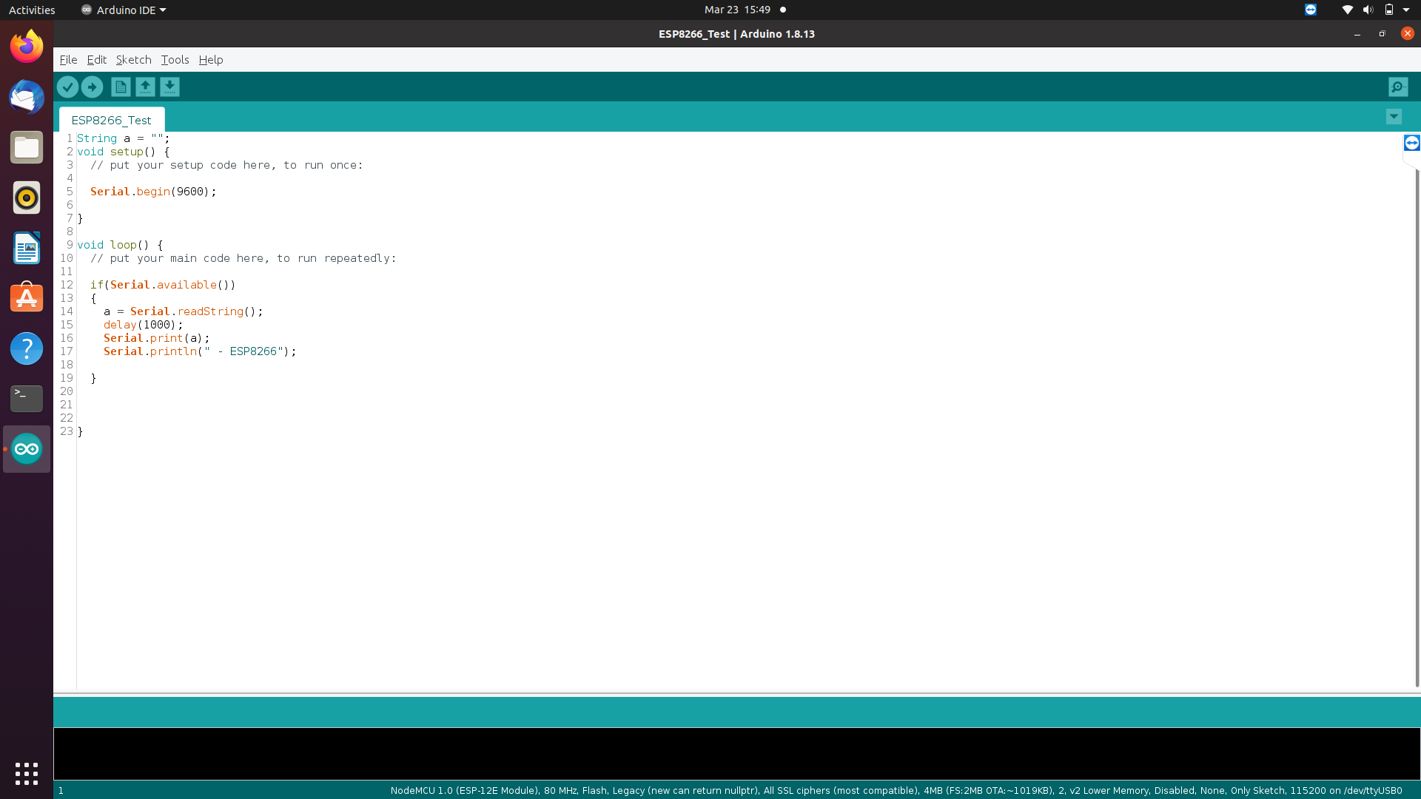
CODE FOR ESP8266

Slide 29
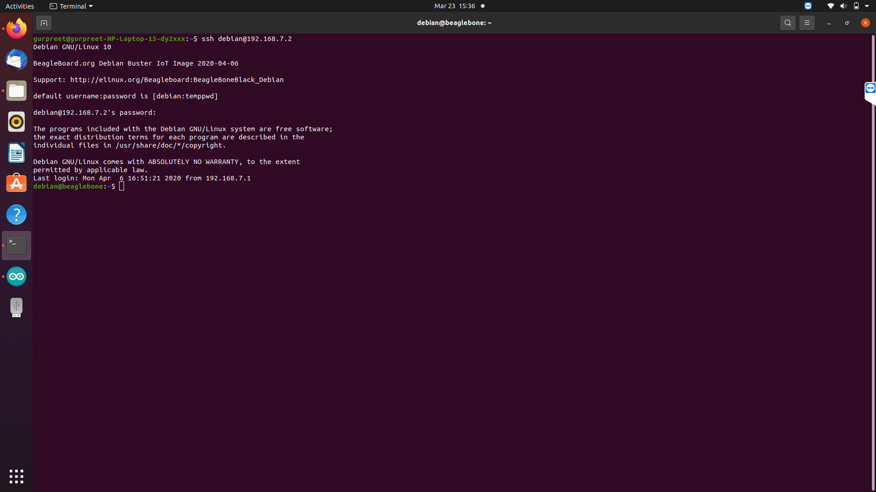

ENTER PASSWORD HERE
TERMINAL COMMANDS
STEP 1: Enter the command “ssh debian@192.168.7.2” here ssh command instruct the system to establish an encrypted secure connection with the host machine. Debian here represent the user_name that is being accessed on the host and then it is followed by an IP address.
STEP2: Before continue to next step, the password “temppwd” must be entered.

Slide 30
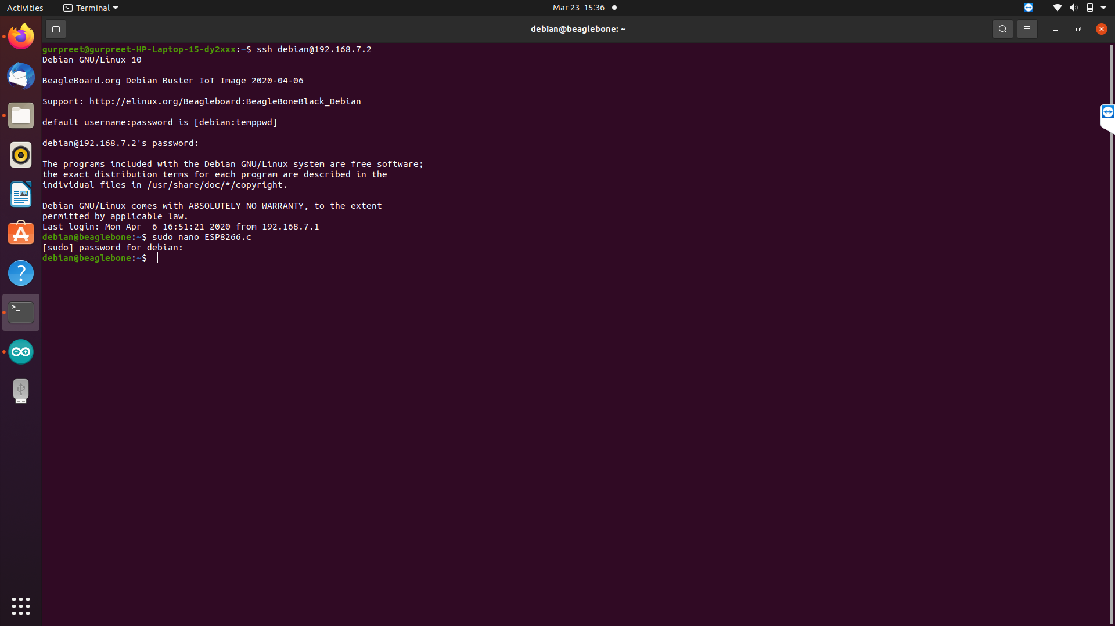
TERMINAL COMMANDS
STEP 3: Enter the command “ESP8266.c” to open Nano text editor and to directly write, edit and navigate the code and to get immediate onscreen feedback. Here, ESP8266.c is the file name. Then enter the same password “temppwd.”
Here CTRL+O : save the code; then press enter; CTRL+X : to exit.

Slide 31
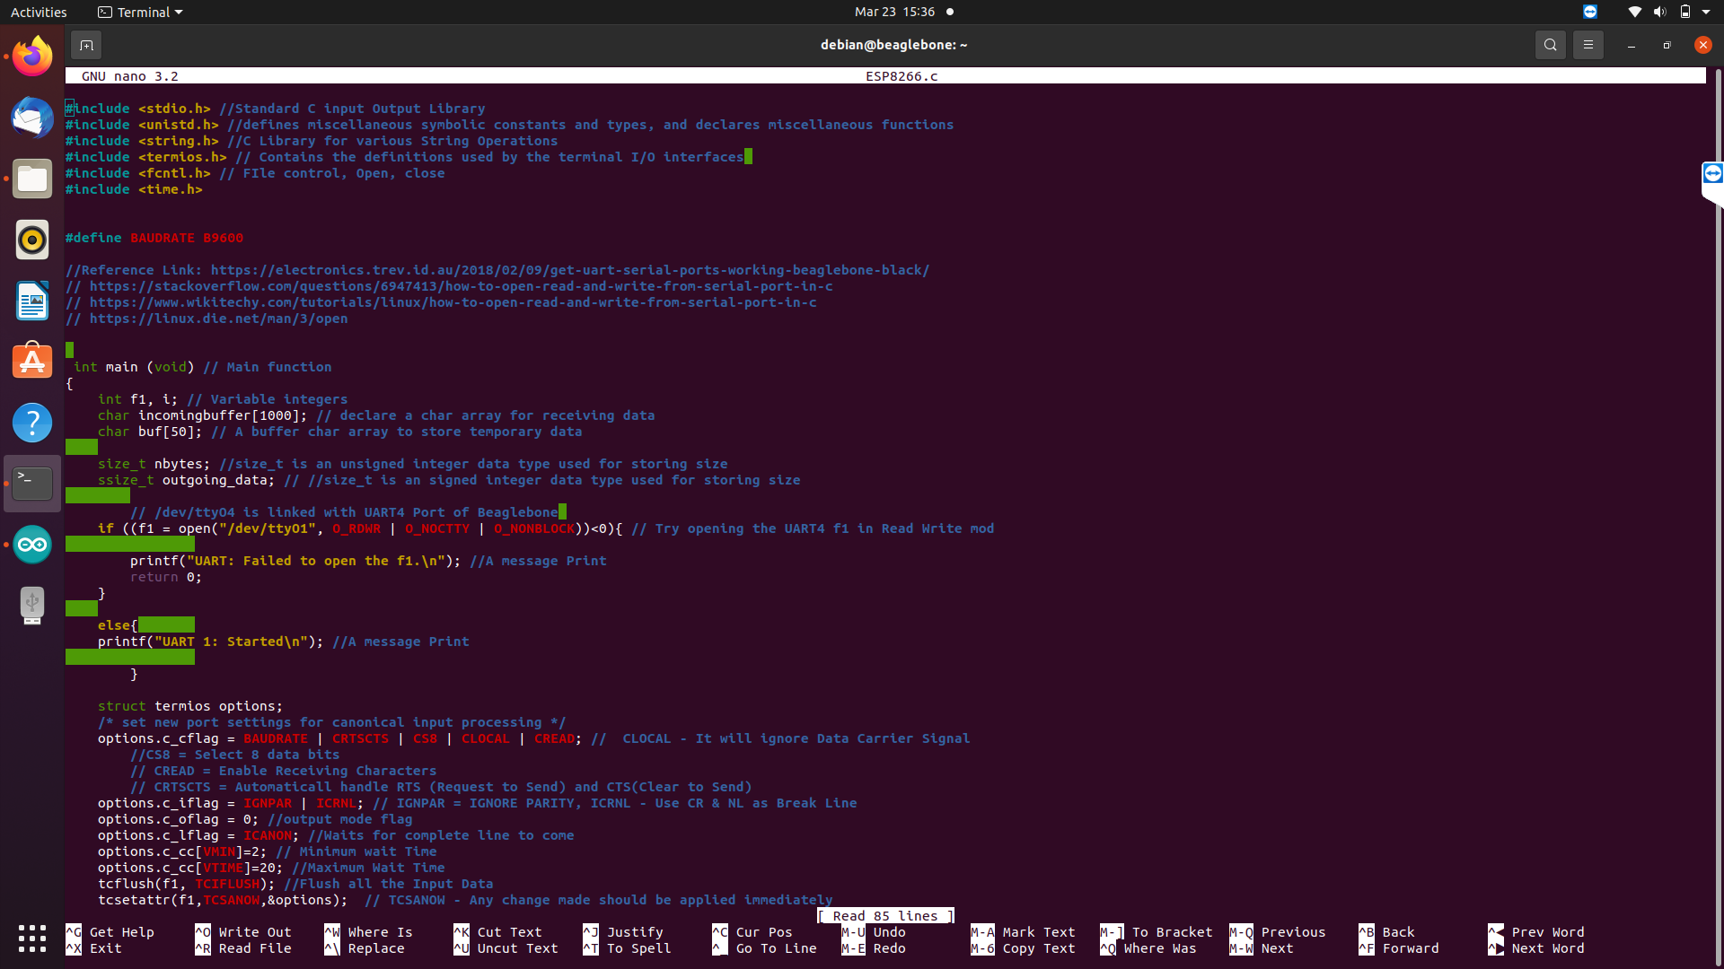
CODING

Slide 32
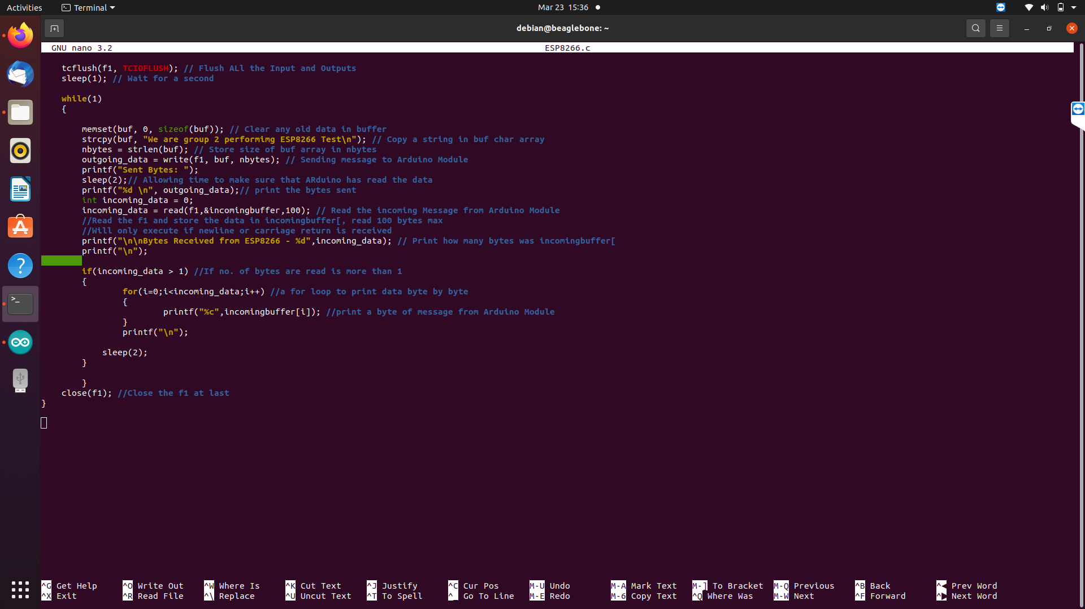
CODING

Slide 33
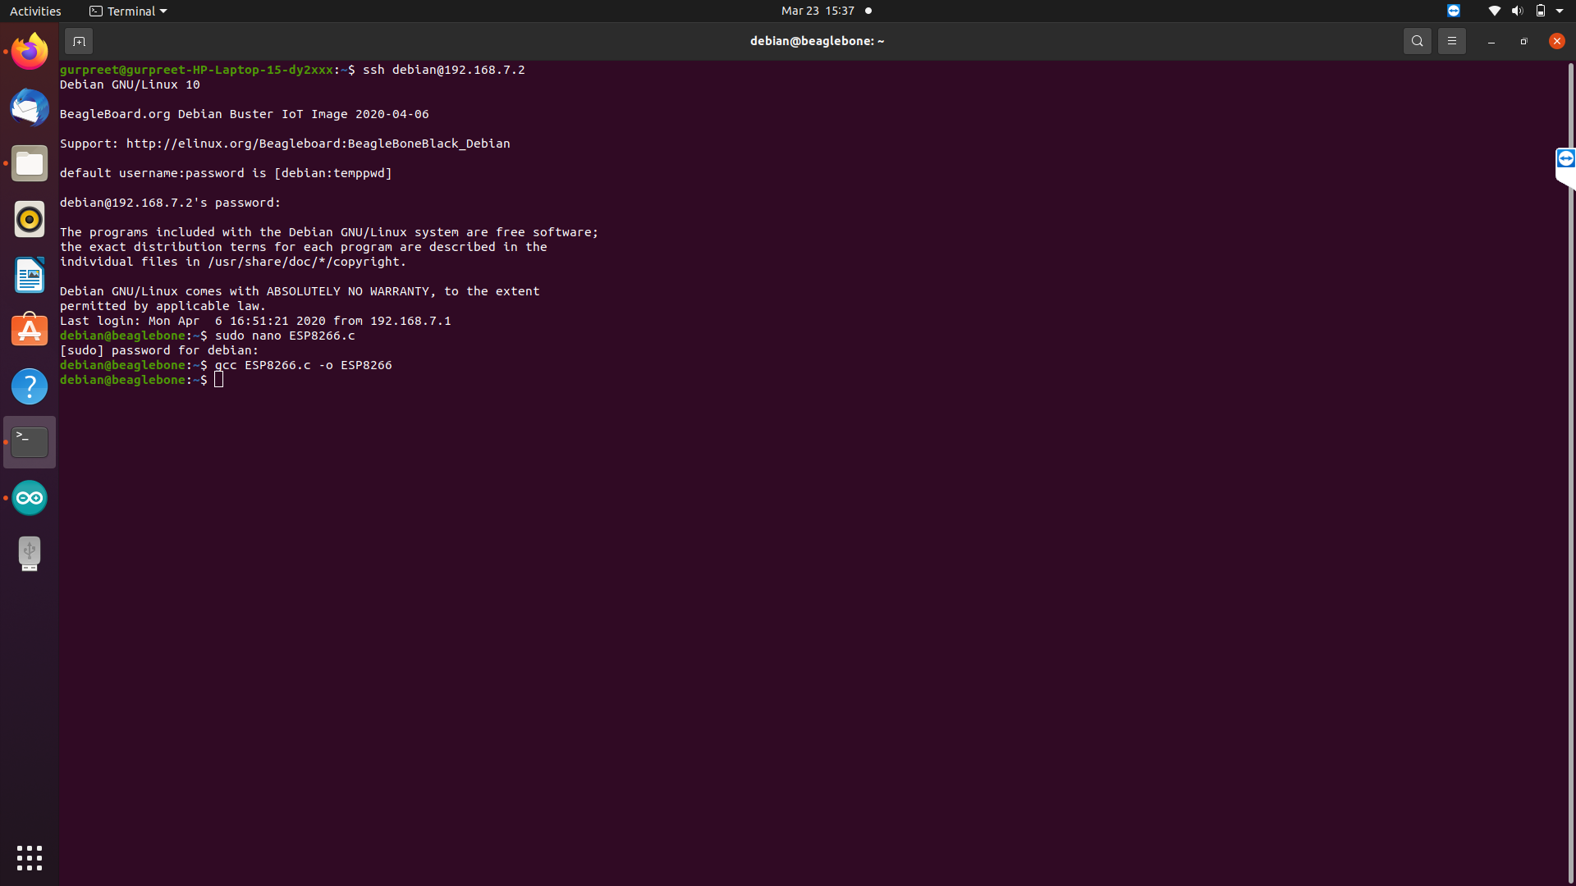
TERMINAL COMMANDS
STEP4: To compile and execute the code, enter the command “gcc ESP8266.c -o ESP8266.” Here, ESP8266.c is the program_name and ESP8266 is the executable file name. Afterwards, press Enter and write the Executable_name : “sudo ./ESP8266.”
STEP5: Again enter the password: temppwd

Slide 34
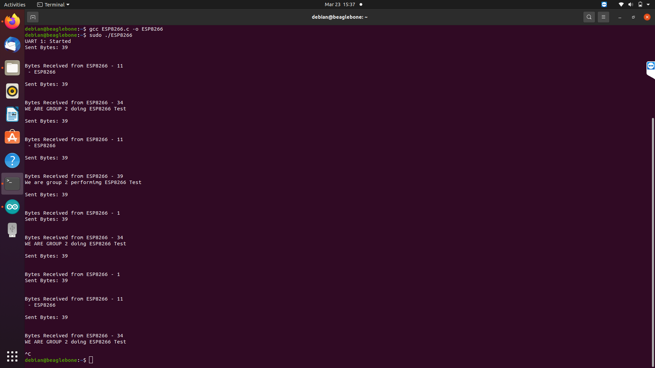
TERMINAL OUTPUT

Slide 35
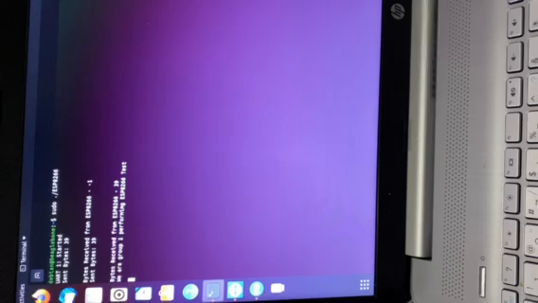
VIDEO

Slide 36
REFERENCES
ESP8266: https://tttapa.github.io/ESP8266/Chap01%20-%20ESP8266.html
Enabling UART port: https://electronics.trev.id.au/2018/02/09/get-uart-serial-ports-working-beaglebone-black.
Interfacing: https://www.wikitechy.com/tutorials/linux/how-to-open-read-and-write-from-serial-port-in-c.
Programming: https://stackoverflow.com/questions/6947413/how-to-open-read-and-write-from-serial-port-in-c.

Slide 37
REFERENCES
NodeMCU GPIO with Arduino IDE. https://www.electronicwings.com/nodemcu/nodemcu-gpio-with-arduino-ide
NodeMCU ESP8266 https://components101.com/development-boards/nodemcu-esp8266-pinout-features-and-datasheet
NodeMCU Documentation https://nodemcu.readthedocs.io/en/release/

Slide 38
THANK YOU

